Slide 1

Banking Data Management with MySQL
PIYUSH TIGAONKAR
© All rights reserved by Fireblaze Technologies Pvt. Ltd.

Slide 2
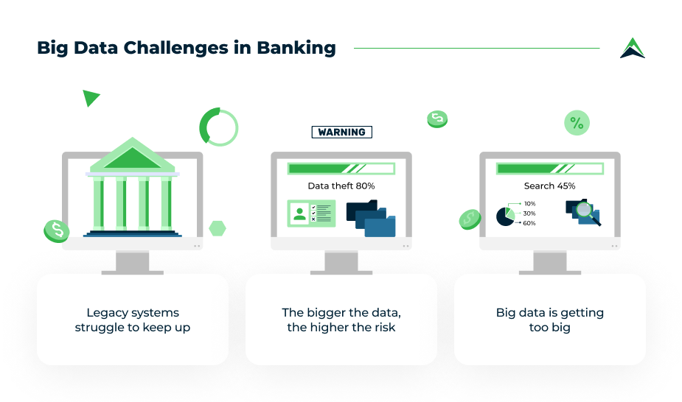
Problem Statement
The aim of this project is to efficiently manage and retrieve data for employees, customers, accounts, and job details in a banking system using MySQL.
The challenge is to implement a robust database system
to handle :-
Storage of multiple entities
(customers, employees, accounts, etc.)
Efficient querying to retrieve specific details,
generate reports, and maintain integrity.
Ensure data accuracy, avoid redundancy,
and simplify operations.
© All rights reserved by Fireblaze Technologies Pvt. Ltd.

Slide 3
Problem Statement
Challenges Addressed :-
Data Redundancy:
Ensuring no duplicate records across different departments and customer accounts.
Efficient Data Retrieval:
Managing complex queries to retrieve customer and employee details across multiple tables.
Data Integrity:
Maintaining accurate relationships between customers, accounts, employees, and departments.
Scalability:
Handling a large dataset across multiple branches with flexibility for future growth.
Query Optimization:
Designing optimized queries for fast retrieval of data, minimizing response time.
Security:
Ensuring sensitive customer information like ATM numbers and PINs are securely managed.
© All rights reserved by Fireblaze Technologies Pvt. Ltd.

Slide 4
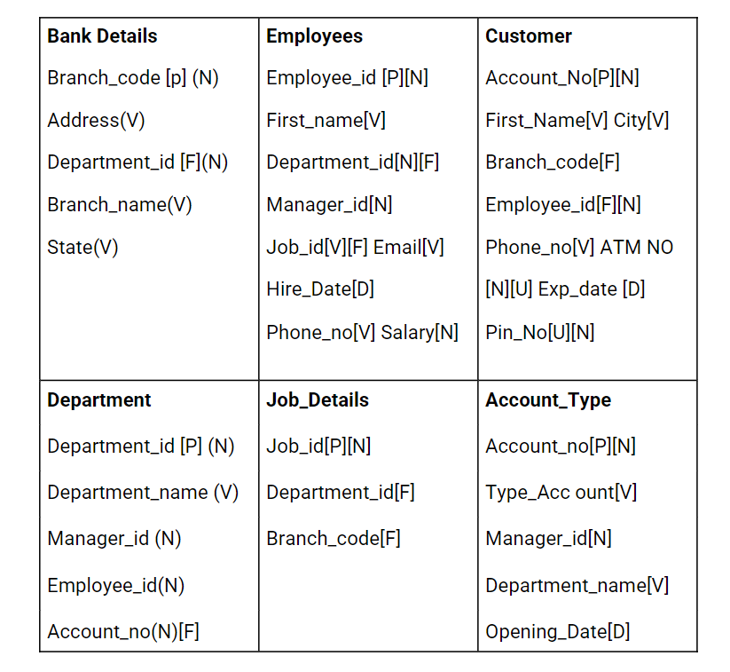
About the Data
The data consists of six key tables:-
ACCOUNT_TYPE -
DEPARTMENT
BANK DETAILS
JOB_DETAILS
EMPLOYEES
CUSTOMER
© All rights reserved by Fireblaze Technologies Pvt. Ltd.

Slide 5
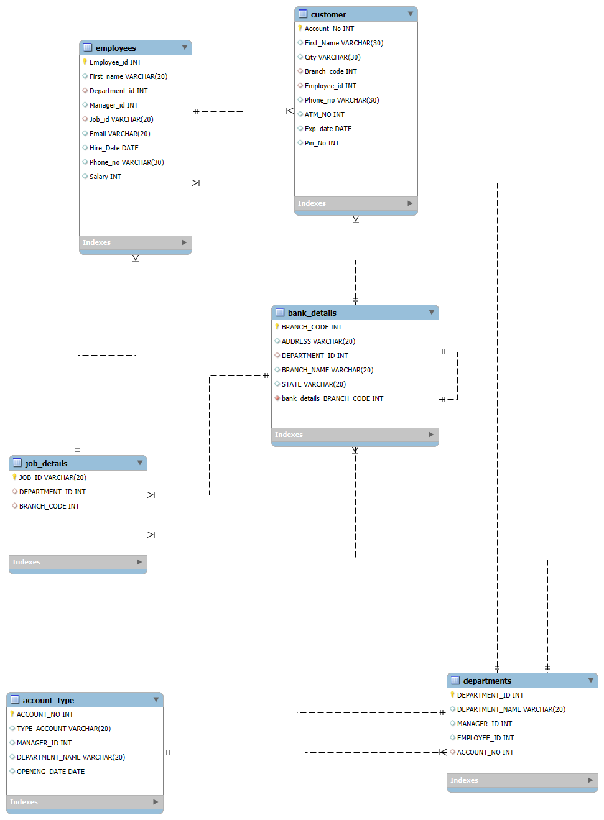
About the Data
The data is structured to establish relationships
through foreign keys, allowing easy querying
and retrieval. :-
© All rights reserved by Fireblaze Technologies Pvt. Ltd.

Slide 6
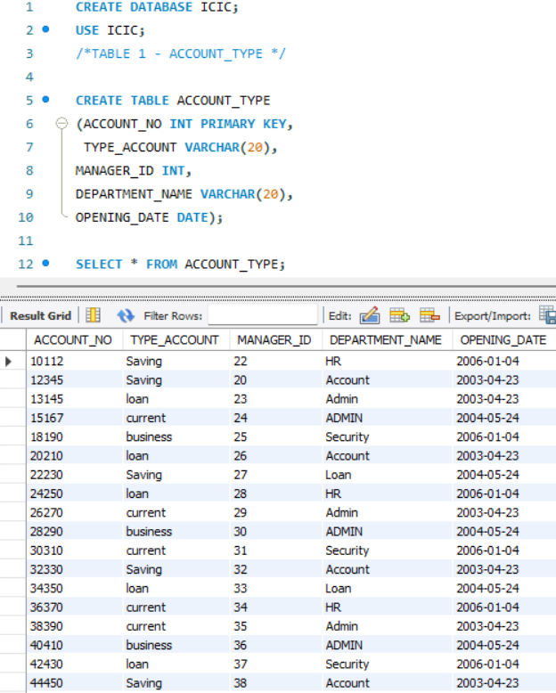
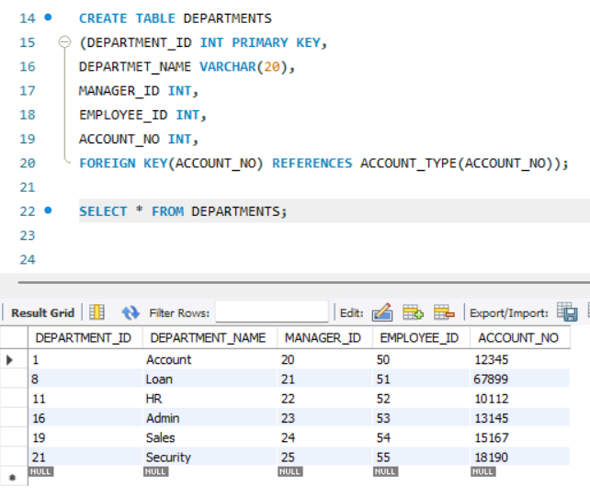
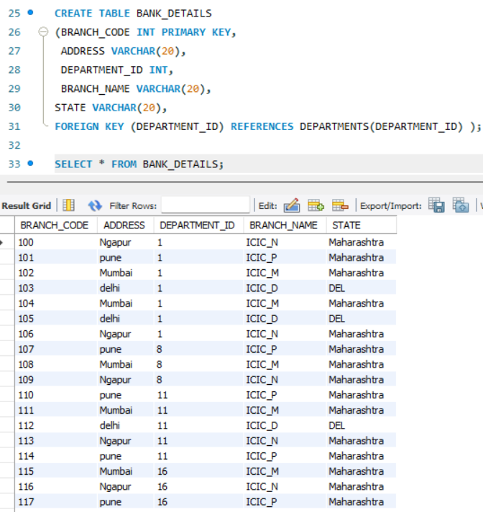
Proposed Solution
Title: Database Schema and Table Creation
© All rights reserved by Fireblaze Technologies Pvt. Ltd.

Slide 7
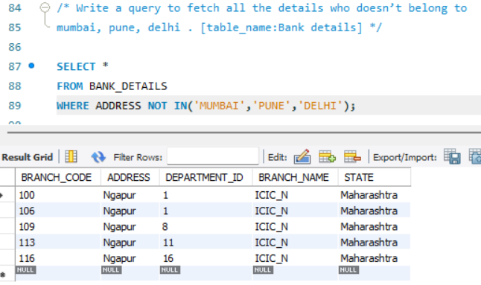
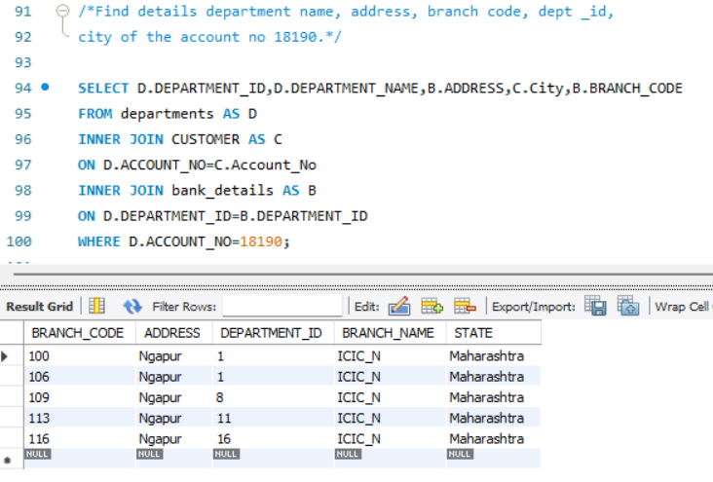
Proposed Solution
Title: Solving Key Data Retrieval Problems
© All rights reserved by Fireblaze Technologies Pvt. Ltd.

Slide 8
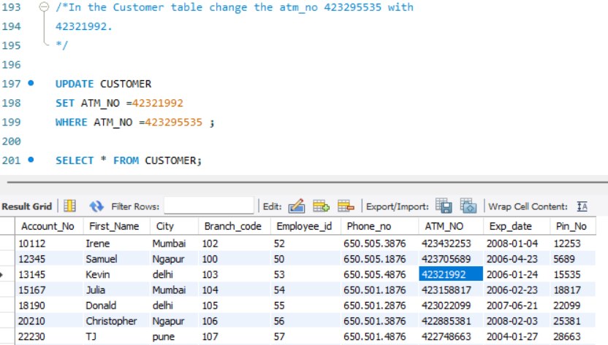
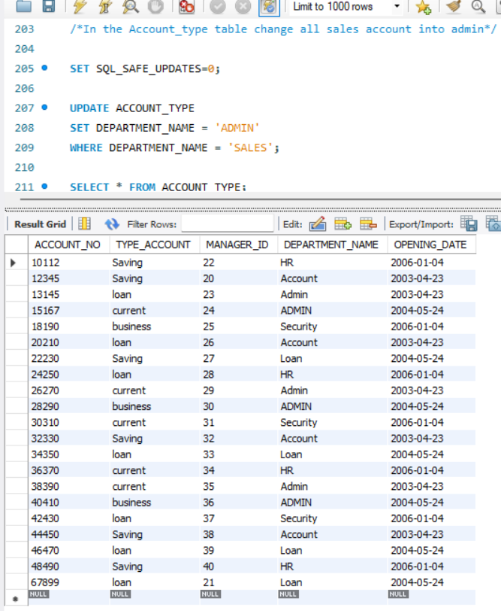
Proposed Solution
TITLE:Data Updation For Better Result
© All rights reserved by Fireblaze Technologies Pvt. Ltd.

Slide 9
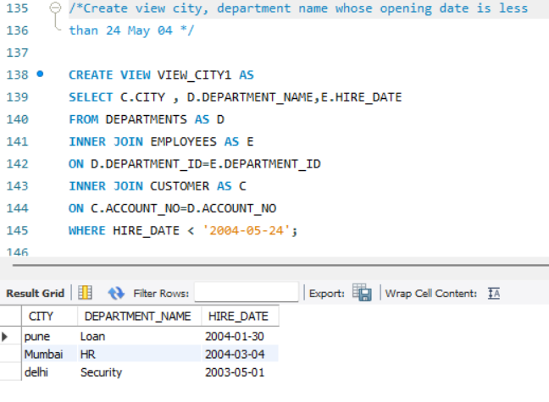
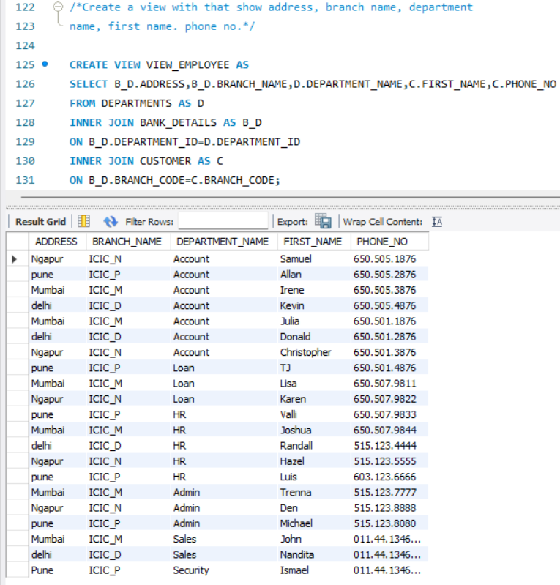
Proposed Solution
Title: Data Views for Better Analysis
© All rights reserved by Fireblaze Technologies Pvt. Ltd.

Slide 10
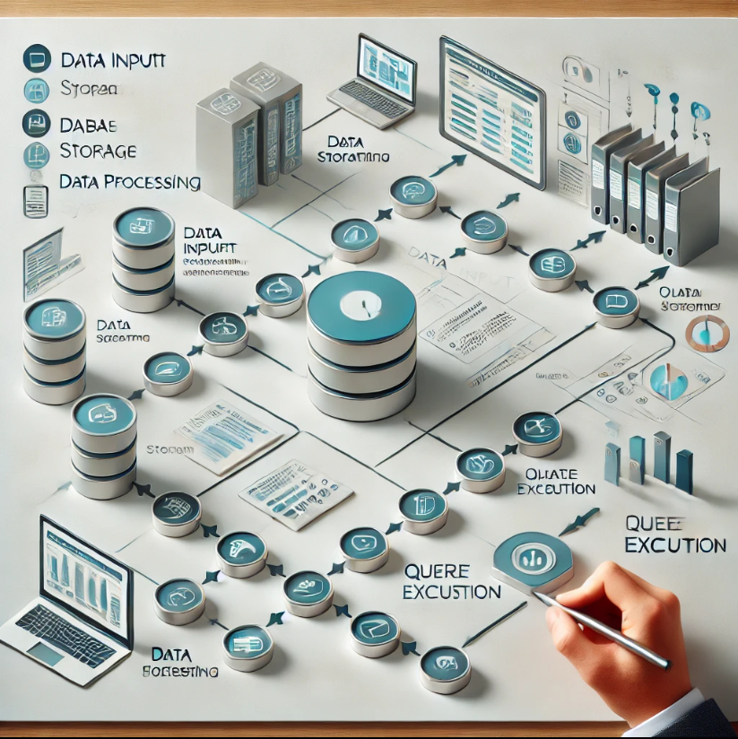
Conclusion
Title: Conclusion
Created a working database system to manage
bank operations smoothly.
Used SQL queries to easily find and update important
informatio about customers and employees.
Improved how the bank handles data, making it easier
for different departments to access and use the information.
This project helps the bank work more efficiently, leading to
better decisions and improved customer service.
© All rights reserved by Fireblaze Technologies Pvt. Ltd.

Slide 11

Future Scope
Advanced Analytics: Use AI to analyze customer behavior and predict trends.
Task Automation: Automate routine tasks like loan approvals with AI.
Data Security: Improve security to protect customer information.
Mobile Integration: Create a mobile-friendly system for easier access.
Scalability: Expand the database to support more customers and services.
© All rights reserved by Fireblaze Technologies Pvt. Ltd.

